Slide 1
Getting a Good Night’s Sleep with Epilepsy
Eilis Boudreau M.D., Ph.D.
Portland VA Medical Center
Epilepsy Center of Excellence & Sleep Medicine Program

Slide 2


Slide 3
Outline
What is the function of sleep?
How much sleep do we need?
Sleep Basics
Common sleep disorders
Best Sleep Practices

Slide 4
Why do we sleep?

Slide 5
Sleep Requirements
Average adult: 7.5-8 hours
Epidemiology: sleep>9 hours or <4 hours have higher chance of death secondary to CAD, stroke and cancer vs 7-8 hour/night sleepers
During pre-light bulb Victorian era, average sleep times closer to 10 hrs/day

Slide 6
How much sleep do we get?

Slide 7
Epidemiology:
2006 CDC Report
http://www.cdc.gov/mmwr/preview/mmwrhtml/mm5708a2.htm

Slide 8
Sleep basics

Slide 9
Sleep Basics
Drive to sleep driven by:
  Internal body clock (circadian)
  How much sleep debt we’ve built up

Slide 10
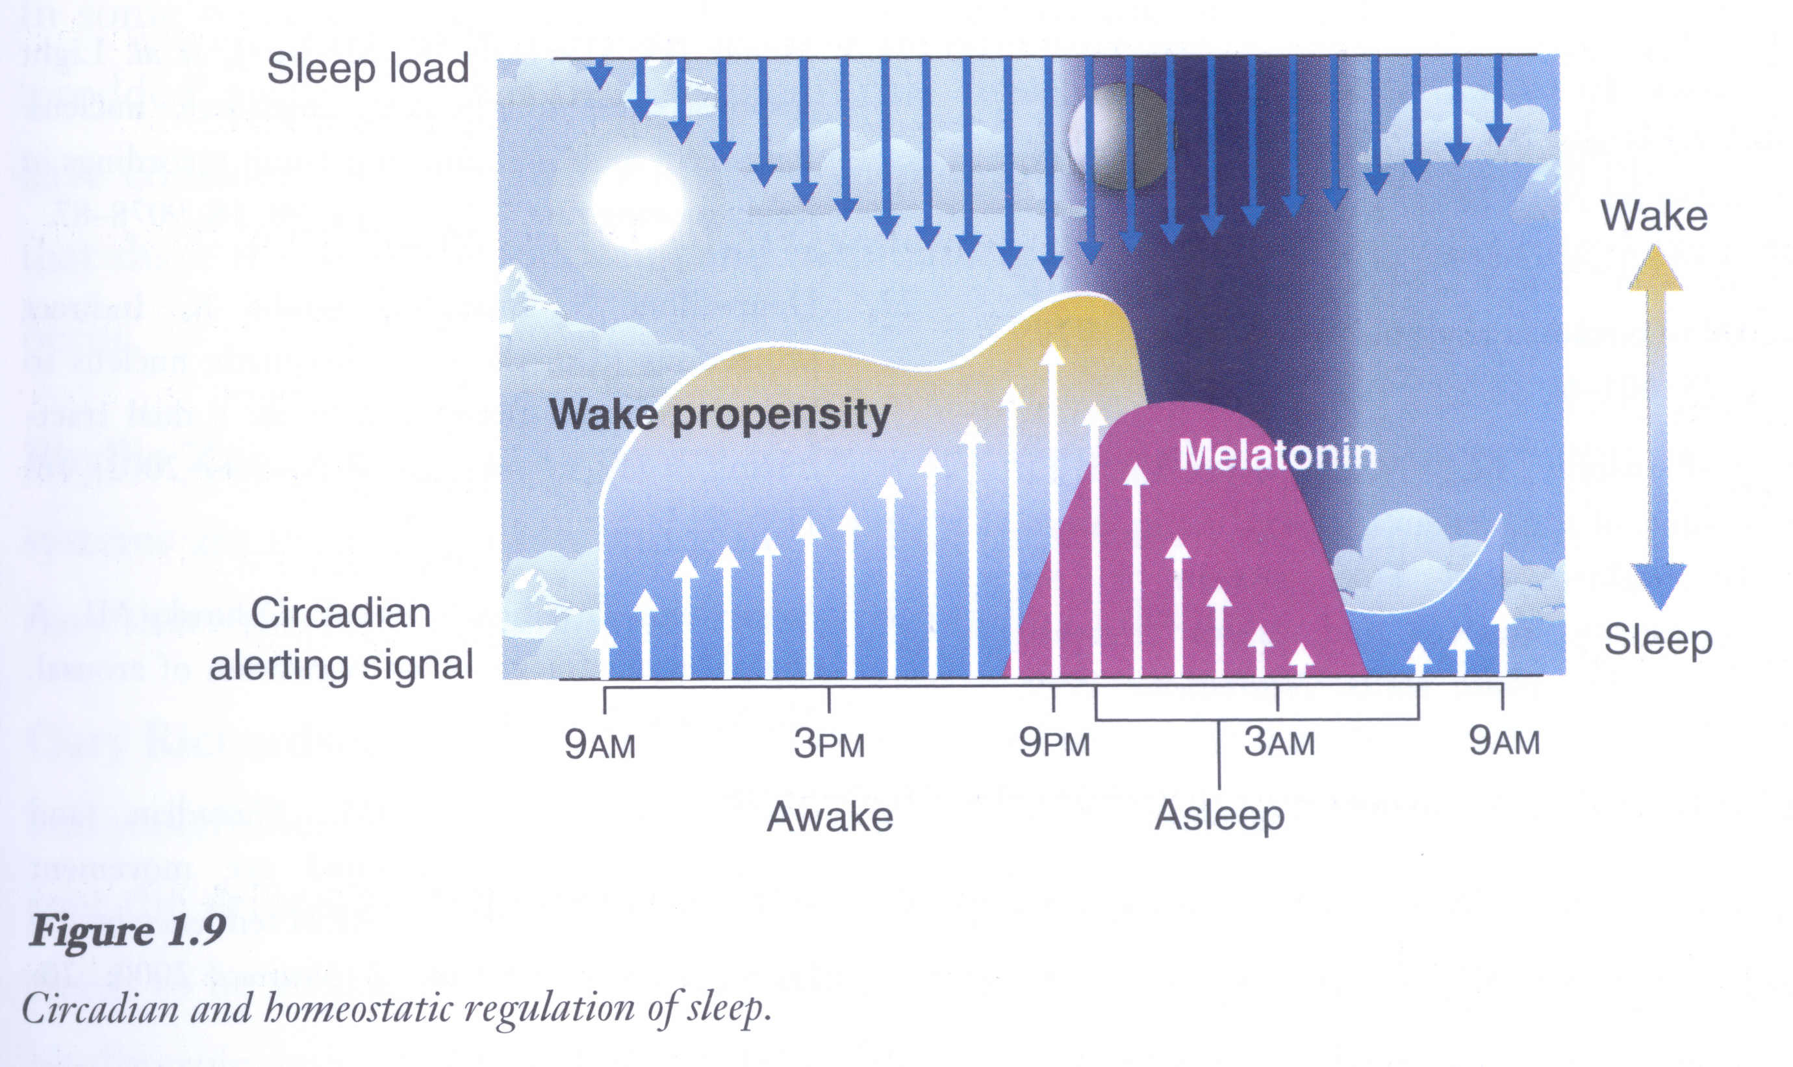
Regulation of Sleep
From “Update on the Science, Diagnosis and Management of Insomnia”, ed Gary Richardson, 2006, pg. 13.

Slide 11
Nighttime Sleep Cycles
Each cycle last approximately 90-110 minutes
4-6 cycles per night
During first cycles Rapid Eye Movement (REM) component only a few minutes
First 2 cycles have significant slow wave sleep
Later cycles dominated by REM
Notes:
We cycle through sleep stages 4-6 times per night. Sleep cycles during the first part of the night are dominated by slow-wave sleep and sleep cycles during the latter part of the night are strongly weighted towards Rapid-Eye Movement sleep.

Slide 12
Common sleep disorders

Slide 13
Most Common Sleep Disorders
Restless Leg Syndrome
Sleep-disordered breathing
Insomnia

Slide 14
Restless Leg Syndrome
Clinical diagnosis
- Urge to move legs
- Begins or worsens during rest
- Relieved with movement
- Worst or only occurs at night

Slide 15
RLS: Epidemiology
Two peaks of incidence
- 2nd decade
- 4th and 5th decades

Slide 16
RLS Treatment
Dopamine agonists (ex. ropinirole)
Other treatments include gabapentin, clonazepam, narcotic meds for very resistant cases
Non-pharmacological: decrease caffeine, nicotine, alcohol; massage legs; warm baths before bedtime

Slide 17
Sleep Disordered Breathing
Episodes of difficulty breathing or cessation of breathing for at least 10 seconds

Slide 18
Sleep Disordered Breathing
Snoring (but many people snore and DON’T have apnea)
Witnessed apneas
Excessive daytime sleepiness
AM headaches
Dry mouth

Slide 19
Factors that Increase Risk for Sleep-Disordered Breathing?
Being overweight
Larger neck circumference
Being a male
Increased age
Post-menopausal

Slide 20
Obstructive Sleep Apnea: Epidemiology
5% - 20% adults
Males > Females

Slide 21
Why treat Sleep-Disordered Breathing?
Short-term: patients feel better and function better
Long-term: prevent long-term complications of apnea

Slide 22
Sleep Apnea and Epilepsy
Treatment of sleep apnea may improve seizure control

Slide 23
Diagnosis and Treatment of
Sleep Apnea
Diagnosis: Overnight sleep study in the sleep laboratory
Treatment: CPAP

Slide 24
Insomnia
Multiple causes.
Is a symptom, many times of multiple issues.
Need to evaluate underlying problems to get at root cause.

Slide 25
Insomnia and Epilepsy
Increased awakenings in patients with epilepsy
  ?seizures
  ?medication side-effects (lamotrigene, felbamate, levetiracetam)

Slide 26
Best sleep practices

Slide 27
Best Sleep Practices
Set-up bedroom only for sleep.
Have a regular sleep routine.
Keep a regular bedtime and wake time.
Protect your sleep time from other activities.
Avoid alcohol before bedtime.
Limit caffeinated beverages.

Slide 28
Sleep in Epilepsy
Seizures at night common with some types of epilepsy.
Seizures can disrupt normal sleep.
Sleep-deprivation may trigger seizures.
Depression and anxiety more common in epilepsy and also disrupt sleep.
Notes:
The exact influence of sleep on seizures is not known but some key observations have been made:
Night-time seizures can disrupt normal sleep.
For many people sleep-deprivation can increase seizure frequency.
Depression & anxiety are more common in epilepsy and it is known that that they can lead to sleep disruption.

Slide 29
Sleep, Epilepsy, and Alcohol
Alcohol may increase chance of seizure (especially binge drinking)
Alcohol significantly disrupts sleep
Significant alcohol intake not good for seizure control or sleep

Slide 30
Summary of What We Know
About Sleep and Epilepsy
Poorer sleep quality
Apnea may be more common and treatment may improve seizure control
Antiepileptic medications may worsen sleep (fragment sleep, increase insomnia)

Slide 31
Best sleep practices

Slide 32
Best Sleep Practices
Set-up bedroom only for sleep.
Have a regular sleep routine.
Keep a regular bedtime and wake time.
Protect your sleep time from other activities.
Avoid alcohol before bedtime.
Limit caffeinated beverages.

Slide 33
Improving Sleep in Epilepsy
Optimize epilepsy treatment
Discuss any medication side-effects with care provider
Practice good sleep hygiene
Identify and treat sleep disorders such as apnea
Tell you care provider if you develop sleep problems

