Slide 1
New anti-seizure medications*
October 25, 2013
Portland VA Medical Center
Victoria Wong, M.D.
&
Paul Motika, M.D.
Department of Neurology
Portland VA Medical Center
OHSU
*and a few non-medication options

Slide 2
Objectives
Review the history of ant-seizure medication development in the last century +
Discuss our experience with older and newer generation anti-seizure medications
Review some of the newer AEDs (Anti-epileptic drugs) and potential future treatments

Slide 3
What are we looking for in an anti-seizure medication?
Effectiveness
  Broad spectrum?
Side effects
Drug-drug interactions
Formulations
  Multiple daily doses versus fewer
Cost
Mechanism of action

Slide 4
Efficacy of anti-epileptic drugs (AEDs)
Monotherapy
1st AED
Monotherapy
2nd AED
Monotherapy
3rd AED
Adjunctive
Therapy
Seizure-free
47%
Newly
diagnosed
epilepsy
n=470
Seizure-free
13%
Uncontrolled
seizures
53%
Seizure-free
1%
Uncontrolled
seizures
40%
Seizure-free
3%
Uncontrolled
seizures
39%
Uncontrolled
seizures
36%
Kwan et al. N Engl J Med 2000;342:314-19

Slide 5
How do we choose seizure medications?
Seizure type
Balance of effectiveness and side effects
Special patient populations
The goal is no seizures, no side effects

Slide 6
Timeline of modern anti-seizure treatment
Bromides
Phenobarbital
Phenytoin
Carbamazepine
Valproate
1850s
1912
1940
1974*
1978*
1880s
1920
1958
1974
Paraldehyde
Ketogenic diet
Ethosuximide
Clonazepam
Notes:
* Carbamazepine originally introduced for trigeminal neuralgia 1958. Valproate also recognized effective 1963

Slide 7
Timeline of modern anti-seizure treatment
1993
2005
1994
2008
1996
2009
Bromides
Phenobarbital
Phenytoin
Carbamazepine
Valproate
1997
2011
1999
2012
1850s
1912
1940
1974*
1978*
2000
1920
1958
Ketogenic diet
Ethosuximide
Felbamate
Gabapentin
Lamotrigine
Topiramate
Tiagabine
(VNS)
Levetiracetam
Oxcarbazepine
Zonisamide
Pregabalin
Rufinamide
Lacosamide
Vigabatrin
Clobazam*
Potiga
Perampanel
1st Generation
2nd Generation
3rd Generation?

Slide 8
How can we organize the AEDs?
Mechanism of action
  Note: drugs may have multiple mechanisms of action
Sodium Channel Blocking | GABA Receptor Agonist | GABA reuptake inhibitors | GABA Transaminase inhibitor | Possible GABA activity | Glutamate Blockers | Other | Potassium Channel Openers
Carbamazepine | Clobazam | Tiagabine | Vigabatrin | Gabapentin | Felbamate | Levetiracetam | Ezogabine
Phenytoin | Clonazepam |  |  | Pregabalin | Topiramate
Oxcarbazepine | Phenobarbital |  |  | Valproate | Perampanel
Lamotrigine | Primidone
Zonisamide
Lacosamide
Valproate

Slide 9
What do we know about the 1st generation AEDs?
Pros:
  Effective, lots of experience with them
  “Broad spectrum” (with some exceptions, such as carbamazepine and ethosuximide)
Cons:
  Side effects, including long-term (e.g. bone density problems)
  Messy pharmacokinetics and interactions
  Interactions with other medications
  Small window of effectiveness without side effects
  More challenging to use in certain populations (women, elderly)

Slide 10
How do the newer generation AEDs compare?

Slide 11
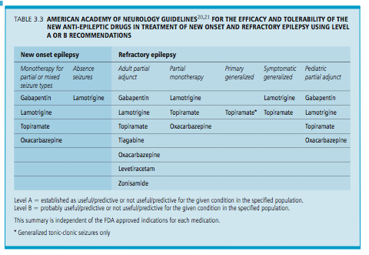

Slide 12
Pharmacokinetics and drug interactions
  Newer AEDs have generally less effects on other AEDs and other medications in general
Liver Enzyme Inducers | Liver Enzyme Inhibitors | Little or no effect
Phenytoin | Valproate | Levetiracetam
Phenobarbital | Felbamate | Lamotrigine
Carbamazepine |  | Zonisamide
Primidone |  | Gabapentin
Oxcarbazepine* |  | Ethosuximide
Topiramate* |  | Lacosamide
 |  | Pregabalin
 |  | Rufinamide
 |  | Vigabatrin
 |  | Clobazam
 |  | Potiga

Slide 13
Pharmacokinetics and drug interactions
Some of the drugs that may be affected by enzyme-inducing AEDs:
  Amiodarone, propranolol, metoprolol, nifedipine, felodipine, nimodipine, digoxin, lovastatin, simvastatin, dicumarol, warfarin, quinidine
  Amitriptyline, nortriptyline, desipramine, clomipramine, citalopram, paroxetine, buproprion, haloperidol, chlorpromazine, clozapine, risperidone, quetiapine
  Cyclosporine, tacrolimus
  Oral contraceptives, prednisone, theophylline, methadone
  Many of the other seizure medications

Slide 14
Special populations
Newer generation AEDs seem to be less teratogenic than first generation (e.g. valproate, phenobarbital), though all AEDs are potentially teratogenic
Newer generation AEDs seem to be better tolerated by other patient groups, such as the elderly, due in part to more favorable side effect profiles and fewer pharmacologic concerns

Slide 15
New Anti-Seizure Medications (in the last few years)

Slide 16
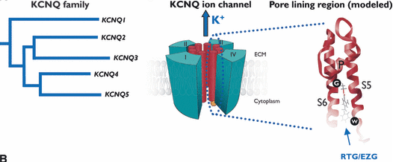
Ezogabine
(Potiga)
New mechanism of action
Opens potassium channels
Sankar et. al. The mechanism of action of retigabine (ezogabine), a first-in-class K⁺ channel opener for the treatment of epilepsy. Epilepsia, vol. 53, issue 3, March 2012.

Slide 17
Ezogabine
(Potiga)
FDA approved for adjunctive (add-on) therapy in partial onset seizures
Similar effectiveness to other 2nd generation AEDs

Slide 18
Ezogabine
(Potiga)
Straightforward pharmacokinetics
Absorbed quickly
Metabolized in the liver though not oxidized by the cytochrome P450 system
3 doses a day
Medication interactions
  Phenytoin, carbamazepine, digoxin

Slide 19
Ezogabine
(Potiga)
Particular adverse effects:
  Urinary retention (2%)
  QT interval lengthening
  Retinal abnormalities (1/3 – need vision tests)
  Blue skin discoloration (10%)
  Psychiatric issues (~10%)
    Suicidality
  Dizziness, fatigue (20+%)

Slide 20
Lacosamide
(Vimpat)
Approved 2009 as adjunctive treatment for partial onset seizures
Affects sodium channels, but by a different mechanism than other AEDs (enhancement of slow inactivation)

Slide 21
Lacosamide
(Vimpat)
Rapidly absorbed
Does not affect the liver cytochrome system
No significant interaction with other AEDs
  However, side effects may be more prominent with other sodium channel blockers
Favorable side effect profile
Twice a day

Slide 22
Lacosamide
(Vimpat)
Effectiveness:
  3 trials over 12 weeks
  Patients with severe epilepsy
  In the 3 studies, the median % reduction of seizure frequency was 35-39%
  33-41% (depending on dose) had a 50% reduction in seizure frequency

Slide 23
Lacosamide
(Vimpat)
Side Effects:
  Dizziness (15-50%)
  Balance problems (1-4%)
  PR prolongation (small %) – use with caution in patients with cardiac history

Slide 24
Clobazam
(Onfi)
Approved 2011 for adjunctive treatment in patients with Lennox-Gastaut syndrome
Used in Canada and European for many years, thus there is a lot of experience
Benzodiazepine family (lorazepam, diazepam)
Several advantages over other benzodiazepines for long term use

Slide 25
Clobazam
(Onfi)
Studies:
  2 multi-center control studies for US approval in patients with LGS
  41-68% reduction in total seizures compared with 12% in the placebo group in one study
  In a second study, there was a reduction of 93% in seizure frequency in a high dose group compared with 29% in a low dose group
  Other prior studies from other countries also

Slide 26
Clobazam (2011)
  Double-blind, placebo-controlled, phase II study for add-on therapy (n=238)
% change
0.25
0.5
0.1
mg/kg/day
Ng YT, et. al. Randomized, phase III study results of clobazam in Lennox-Gastaut syndrome. Neurology 2011;77:1473–1481

Slide 27
Clobazam
(Onfi)
Side effects:
  Clobazam has a slightly different structure than usual benzodiazepines
  Almost 10 x decrease in sedative effects, and significant decrease in anxiolytic effects
  Similar types of side effects compared with other benzodiazepines: SEDATION (25%), dizziness, balance problems (5-10%)

Slide 28
Clobazam
(Onfi)
Overall:
  Effective in a wide range of epilepsy (including partial epilepsy) and seizure types
  Major issue is tolerance (1/3) and side effects
  Can also be used short term (catamenial)

Slide 29
Perampanel
(Fycompa)
Approved 2012 as adjunctive treatment for partial onset seizures, but delayed by DEA (controlled substance?)
Different mechanism of action:
  Noncompetitive antagonist of AMPA glutamate receptors

Slide 30
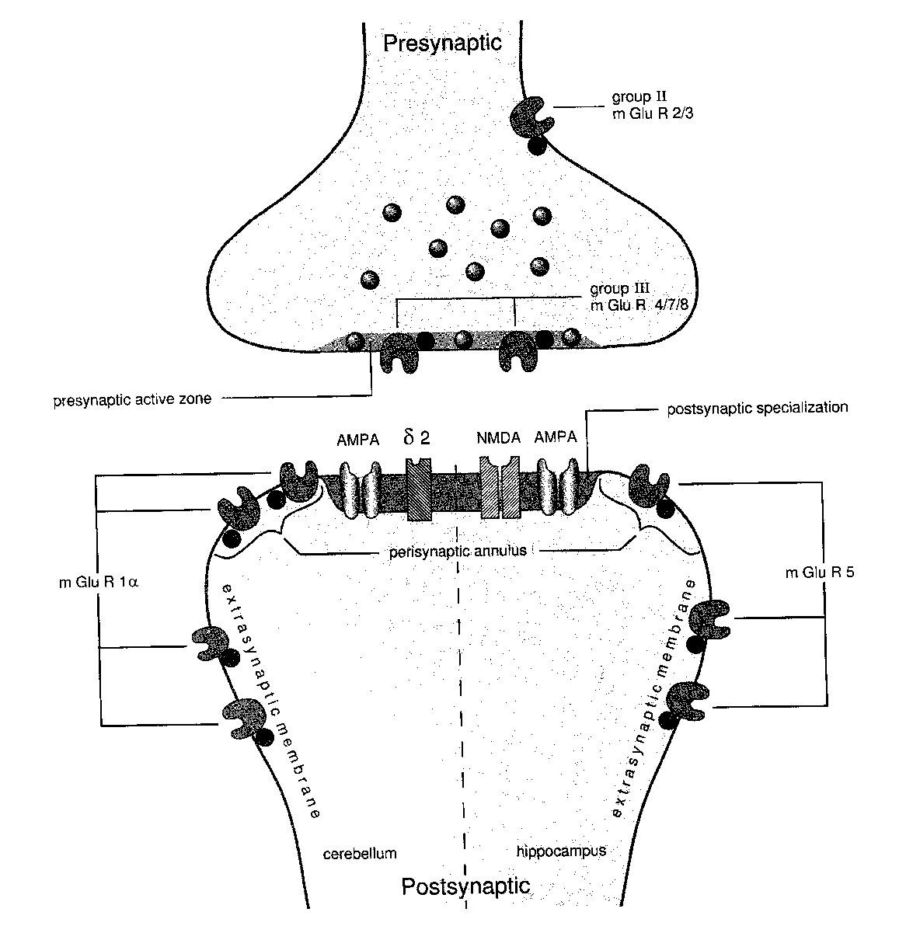
Animal models show that NMDA, AMPA stimulation/agonists induce seizure activity
Takumi et al. 1998
Notes:
At resting potential, AMPA receptor is closed to ion flow. Glutamate binding opens this allows cations to flow, resulting in brief EPSP. SODIUM is the main carrier of the current.
AMPA has been shown to be involved in seizure generation.

Slide 31
Perampanel
(Fycompa)
Effectiveness
  3 trials; used as add-on therapy
  Various doses compared
  Response rates were 29-35%
  Mean % declines in seizures were 23-30% depending on the dose

Slide 32
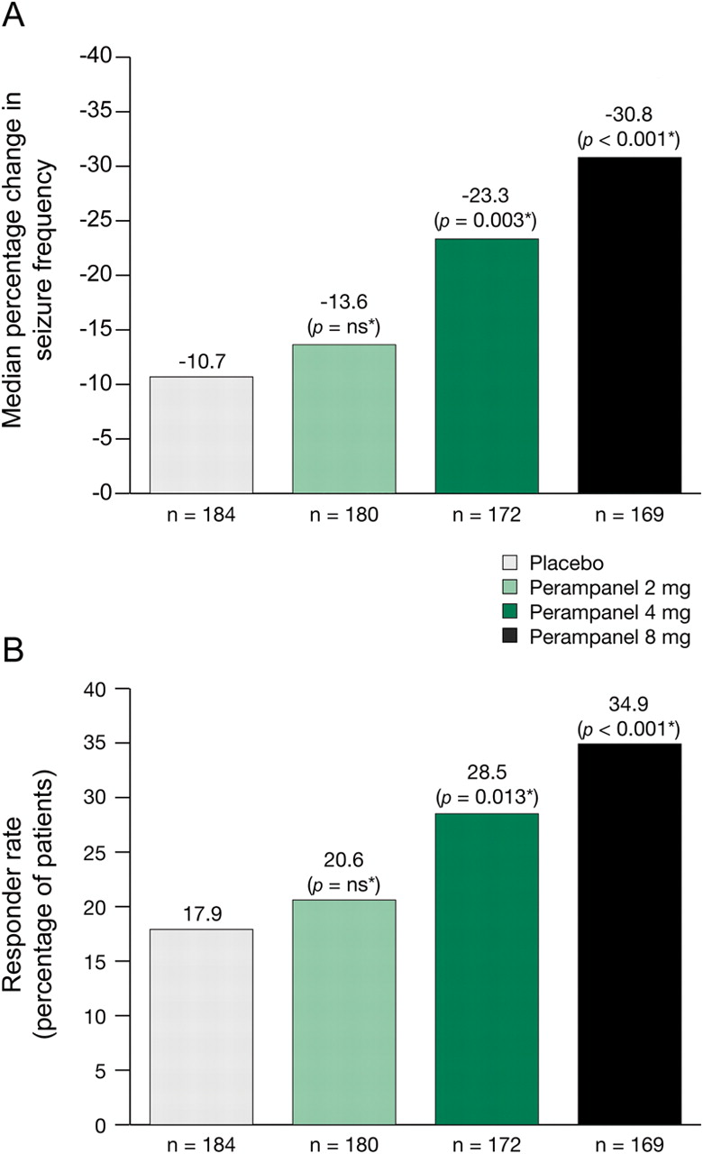

Median percentage change in seizure frequency per 28 days and responder rate
Krauss G et al. Neurology 2012;78:1408-1415
©2012 by Lippincott Williams & Wilkins
Notes:
Median percentage change and responder rate(A) Median percentage reduction in seizure frequency per 28 days (ITT population). (B) Responder rates (ITT population). *Vs placebo. ITT = intent-to-treat; ns = not significant.

Slide 33
Perampanel
(Fycompa)
Pharmacology
  Metabolized in the liver, including via the cytochrome P450 system
    Some drug interactions possible.
  Once a day dosing
Drug interactions
  Perampanel may decrease effectiveness of hormonal contraceptives.
  Other AEDs may affect perampanel

Slide 34
Perampanel
(Fycompa)
Major concern: Black box warning:
“WARNING: SERIOUS PSYCHIATRIC AND BEHAVIORAL REACTIONS. Serious or life-threatening psychiatric and behavioral adverse reactions including aggression, hostility, irritability, anger, and homicidal ideation and threats have been reported in patients taking Fycompa. These reactions occurred in patients with and without prior psychiatric history, prior aggressive behavior, or concomitant use of medications associated with hostility and aggression”

Slide 35
Treatments on the Horizon

Slide 36
Eslicarbazine acetate (Sunovion)
Related to carbamazepine, oxcarbazepine
Not metabolized to carbazepine 10,11-epoxide, unlike CBZ
Weak enzyme-inducer
Metabolized primarily to S-enantiomer, whereas oxcarbazepine is metabolized to both S- and R-enantiomer (perhaps improved crossing of the blood-brain barrier)
Accepted by FDA for potential approval

Slide 37
Eslicarbazine acetate (Sunovion)
Analysis from three large studies
Add-on therapy for partial-onset seizures
Doses of 400, 800, 1200 mg daily
Seizure frequency reduced with 800 (35%) and 1200 (39%) mg daily doses
Responder rate 36 and 44% respectively
Gil-Nagel, A. et. al. Efficacy and safety of eslicarbazepine acetate as add-on treatment in patients with focal-onset seizures: Integrated analysis of pooled data from double-blind phase III clinical studies. Epilepsia. 2012 Aug 6.. 1528-1167.

Slide 38
Brivaracetam (UCB)
Similar to levetiracetam
Synaptic vesicle 2A ligand
Appears to be well-tolerated
Appears to demonstrate efficacy compared with recent AEDs
However, efficacy results mixed at this point
  One of two large phase III trials did not meet primary endpoint
Another phase III trial underway
IV formulation also being investigated
French et al. Adjunctive brivaracetam for refractory partial-onset seizures: a randomized, controlled trial. Neurology 2010;75:519–5255
Biton V et al. Brivaracetam as adjunctive treatment of refractory partial-onset seizures in adults: Results from two randomized, double-blind, placebo-controlled trials Epilepsia 2009;50(Suppl.11):106–107

Slide 39
Some other AED medications in development
Intranasal midazolam*
Ganaxalone
BGG492
Deoxyglucose (2DG)
ICA-105665
VX765
YKP3089
(Not a complete list)
Source: Epilepsy Therapy Project. http://www.epilepsy.com/etp/pipeline_new_therapies

Slide 40
Two Devices Under Investigation For Epilepsy Treatment
NeuroPACE
Sante

Slide 41
Responsive Neurostimulation (NeuroPace, Inc)
Implanted neurostimulator
Electrodes at seizure focus site
Detects seizure activity and provides stimulation

Slide 42
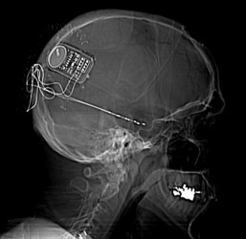
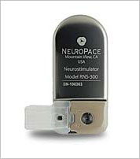

Slide 43
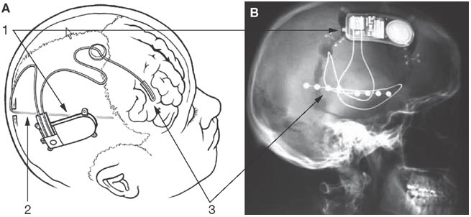
Technology Insight: neuroengineering and epilepsy—designing devices for seizure control William C Stacey and Brian Litt Nature Clinical Practice Neurology (2008) 4, 190-201

Slide 44
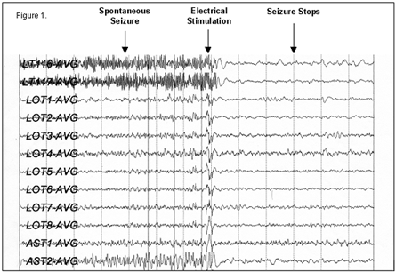
Bergey, GB, et.al., Implementation of an external responsive neurostimulator system (eRNS) in patients with intractable epilepsy undergoing intracranial seizure monitoring. Epilepsia Vol 43, Suppl 7, 2002

Slide 45
Responsive Neurostimulation (NeuroPACE,Inc)
Randomized, double-blind, sham-stimulation controlled trial (n=191; 32 clinical centers)
Patients with medically intractable partial epilepsy and 1 or 2 seizure foci
12 week blinded period; 84 week open label
Seizures significantly reduced in treatment versus sham group in 12 week blinded period (-37.9% vs. -17.3%; p = 0.012).
29% of patients in active group had seizures improved by 50%
Sustained in open label period
Morrell, MJ et. al. Responsive cortical stimulation for the treatment of medically intractable partial epilepsy. Neurology. 2011 Sep 27;77(13):1295-304.

Slide 46
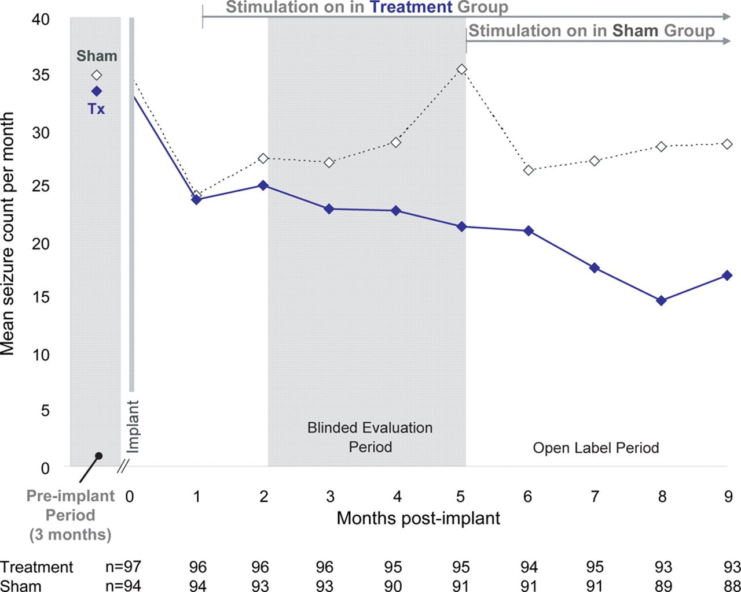
Mean disabling seizures by month
Morrell M J Neurology 2011;77:1295-1304
©2011 by Lippincott Williams & Wilkins
Notes:
Mean disabling seizures by month, observed data N represents the number of subjects with seizure data during that interval. Randomization occurs at 1 month postimplant. The treatment group begins to receive responsive stimulation during the stimulation optimization period and continues to receive responsive stimulation through the blinded evaluation period (BEP). The sham group does not receive responsive stimulation until after the BEP.

Slide 47
Mean disabling seizures by month, observed data N represents the number of subjects with seizure data during that interval.
Morrell M J Neurology 2011;77:1295-1304
©2011 by Lippincott Williams & Wilkins
Notes:
Mean disabling seizures by month, observed data N represents the number of subjects with seizure data during that interval. Randomization occurs at 1 month postimplant. The treatment group begins to receive responsive stimulation during the stimulation optimization period and continues to receive responsive stimulation through the blinded evaluation period (BEP). The sham group does not receive responsive stimulation until after the BEP.
** FDA worried that sham not statistically different in first 2 months and stim group only separated after third month. Maybe anesthesia effect? Want longer blinded period – 6 months or more – to evaluate efficacy. APPEALING. Believe statistics good. FDA not ready to make determination.

Slide 48
SANTE
Stimulation of the Anterior Nucleus of the Thalamus for Epilepsy
Continuous stimulation
Bilateral anterior thalamic nucleus implants (n=110) in patients refractory to medical and surgical interventions
Three month blinded stimulation vs. sham
Fisher R, et al.: Electrical stimulation of the anterior nucleus of thalamus for treatment of refractory epilepsy. Epilepsia 51:899–908, 2010

Slide 49
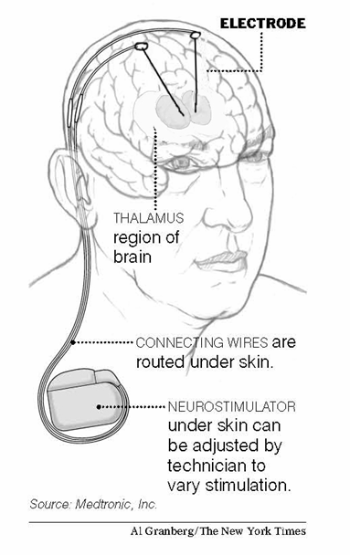
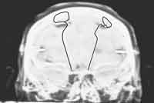
SANTE
Fisher R, et al.: Electrical stimulation of the anterior nucleus of thalamus for treatment of refractory epilepsy. Epilepsia 51:899–908, 2010

Slide 50
SANTE
40.4% median reduction in seizure frequency compared with baseline in treatment group at the end of 3 months compared with 14% in controls (p<0.038)
In open label, continued improvement reported (at 2 years, 56% median seizure reduction, at 3 years 68%)
Fisher R, et al.: Electrical stimulation of the anterior nucleus of thalamus for treatment of refractory epilepsy. Epilepsia 51:899–908, 2010
Notes:
Approved Europe and Canada not FDA

Slide 51
SANTE
p=0.039 for the primary outcome, excluding 1 outlier
p=0.002 for final month, including outlier

Slide 52
SANTE
Sustained long term effects
  Seizure reduction from baseline at
    1 year: 41%
    2 years: 56%
    5 years was 69%
  Responder rates:
    1 year: 43%
    2 years: 54%
    5 years: 69%
V. Salanova, R. Fisher, G. Sante. LONG TERM EFFICACY OF THE SANTE TRIAL. AES meeting, 2012. Abst 1.272.
Notes:
Approved Europe and Canada not FDA

Slide 53
Conclusions
There have been several recent additions to the seizure medication formulary which have improved our ability to care for patients with epilepsy
Many interesting new therapies are being explored

Slide 54
New anti-seizure medications*
October 25, 2013
Portland VA Medical Center
Victoria Wong, M.D.
&
Paul Motika, M.D.
Department of Neurology
Portland VA Medical Center
OHSU
*and a few non-medication options

