Slide 1
Getting comfortable with VNS Programming
Edward Maa, MD
Chief of the Comprehensive Epilepsy Program- DHMC
Associate Professor of Neurology- University of Colorado and DVAMC

Slide 2
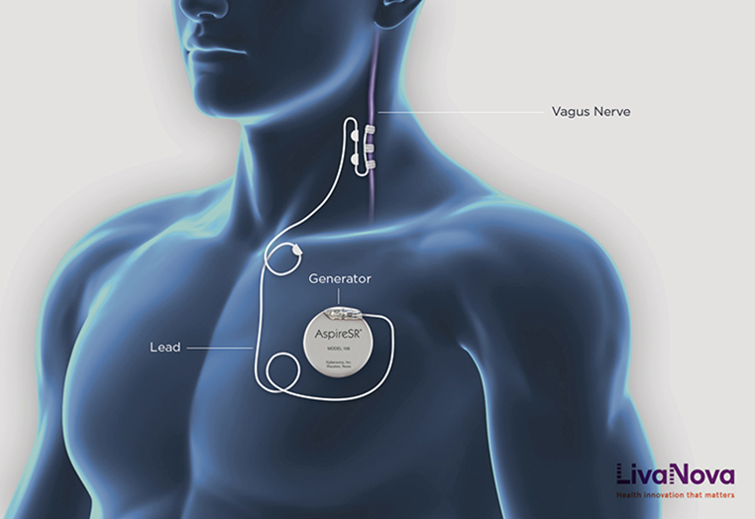
First Clinic Visit
Usually >2 weeks after implantation
Visualize surgical site for wound healing (erythema, fluid accumulation, drainage, incision approximation, mobility of device, coil protrusion, etc…)

Slide 3
Typical Clinic Visit
Interrogate generator
Titrate/Program parameters
System Diagnostics
Verify Heartbeat Detection and Sensitivity, if needed (Aspire SR 106 only)
Interrogate generator AGAIN

Slide 4
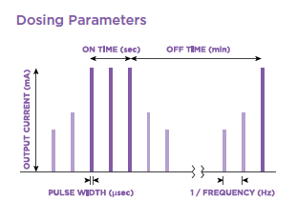
Dosing Parameters

Slide 5
FIRST GOAL: Ramp Output Current
Generate a compound action potential on the vagus nerve by creating a charge
Increase Output Current in 0.25 mA steps to therapeutic range (1.5 - 2.25 mA) as quickly as tolerable

Slide 6
Normal Mode

Slide 7
Magnet Mode

Slide 8
AutoStim Mode

Slide 9
FIRST GOAL: Ramp Output Current

Slide 10
Managing Stimulation Side Effects
Pulse Width 500 → 250 µsec
Signal Frequency 30 → 25 → 20 Hz
Output Current ↓0.25 mA
↓0.125 mA (Aspire SR)

Slide 11
SECOND GOAL: Maximize AutoStims
Adjust Sensitivity of Heartbeat Detection to accurately pick up pulse (start with 1 and increase to 5- typically tested and verified in OR at time of implantation but can be modified later)
Adjust Threshold of “Change in Heart Rate”. (Default is 70%, usually advanced to 40% at time of implantation. Maximum % change is preferred to decrease false positive treatments)
During Interrogation, # of Autostims should target 40-60 stims per day. Adjust Threshold accordingly.

Slide 12
Tachycardia Detection

Slide 13
Verify Heartbeat

Slide 14
Managing AutoStim-Related Side Effects
Verify Heartbeat Detection: Adjust sensitivity
AutoStim Parameters:
↓Pulse Width
↓Output Current
↓ON TIME
Autostim Threshold: ↑ 10%

Slide 15
THIRD GOAL: Ramp Duty Cycle
Increase duty cycle over time and assess clinical outcome
Increase the amount of time stimulation is being delivered in a 24-hour period

Slide 16
Dosing Parameters

Slide 17
THIRD GOAL: Ramp Duty Cycle

Slide 18
THIRD GOAL: Ramp Duty Cycle

Slide 19
Verify by Interrogating AGAIN

Slide 20
Personal Notes
Tailoring titration to tolerability is more important than rigid adherence to programming targets, especially early.
History of frequent/very brief events may require “Rapid Cycling” programming, even sacrificing AutoStim
Seizure frequency reduction post implant and prior to turning on device tends to suggest good response to therapy when therapeutic dosing is reached.
“0.75 Syndrome”
Multistep dosing in same visit is common, especially when patient is remote to clinic
If patient keeps good seizure log, downloading VNS data may help verify if autostim or magnet activations were triggered at time of clinical seizure (default timestamps CST- Houston)
Watch for asthma and OSA exacerbation post implant; screen beforehand
Significant SOB with stimulation may be current leak to Phrenic nerve

